Slide 1
California Landfill Policies

Slide 2
Major Landfill Policies
Gas Collection and Flaring
Low Carbon Fuel Standard
Waste Reduction

Slide 3
Gas Collection and Flaring
EPA’s general guidelines to install gas collection and flaring equipment for landfills with a capacity >2.5 million metric tons.
Approximation based on the regulation of NMVOCs
California, beginning in 2010, requires installation of gas collection and flaring equipment for landfills with a capacity >450,000 tons of waste to control GHG emissions
Source: CA Legislature. 2008. FINAL REGULATION ORDER
CARB. 2014. Stationary Source Division Emissions Assessment Branch

Slide 4
Gas Collection and Flaring Implementation in Scenarios
Implementation Proposal: Gradually require that landfills >450 million metric tons gradually install gas collection and flaring equipment.
By 2040 about 25% of U.S. candidate landfills w/o flares would need to install flaring technology
Source: CA Legislature. 2008. FINAL REGULATION ORDER
CARB. 2014. Stationary Source Division Emissions Assessment Branch

Slide 5
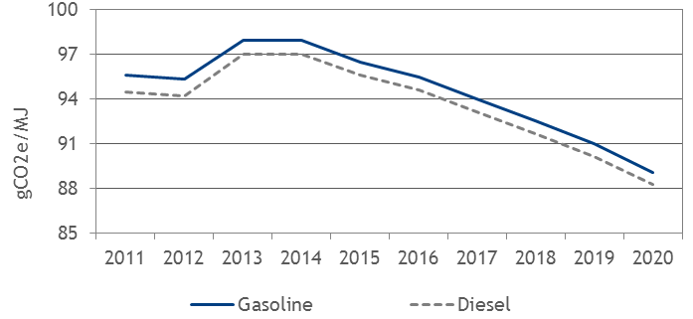
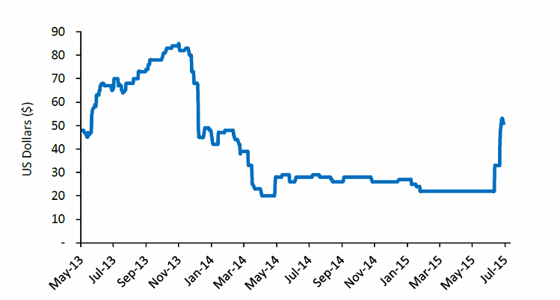
Low Carbon Fuel Standard Credits
10% absolute GHG emissions reduction from petroleum fuel by 2020
Credits generated for fuels with lower than the GHG emission standard

Slide 6
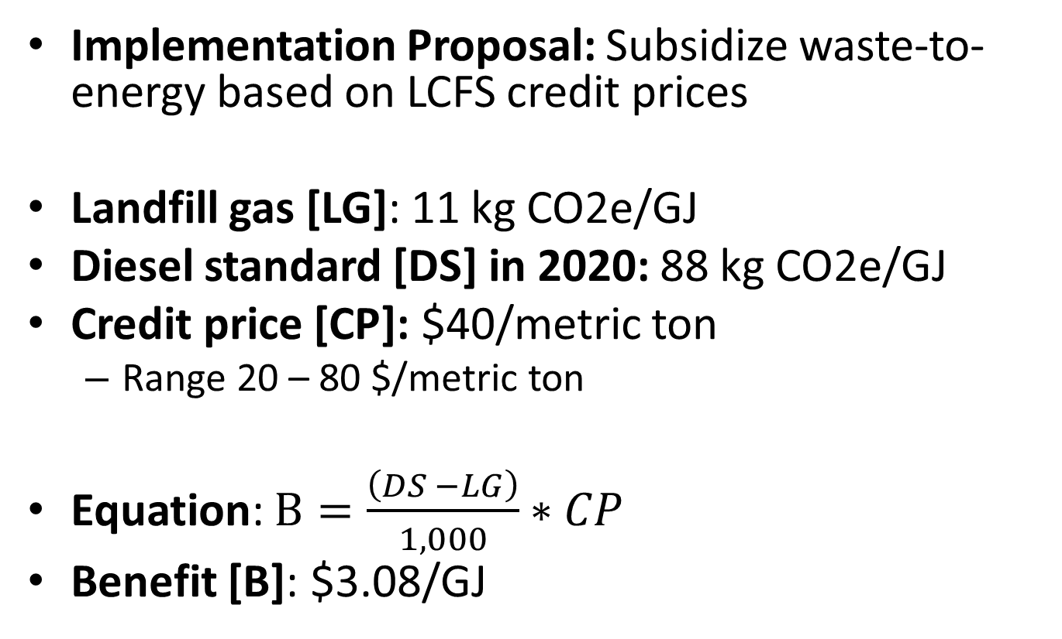
LCFS Implementation in Scenarios
Implementation Proposal: Subsidize waste-to-energy based on LCFS credit prices
Landfill gas [LG]: 11 kg CO2e/GJ
Diesel standard [DS] in 2020: 88 kg CO2e/GJ
Credit price [CP]: $40/metric ton
Range 20 – 80 $/metric ton
Equation: $B=\frac{\left(DS −LG\right)}{1,000}∗CP$
Benefit [B]: $3.08/GJ
Sources: Argus Media. 2015.
CARB. 2014. Table 7. Carbon Intensity Lookup Table for Diesel and Fuels that Substitute for Diesel.
CARB. 2014. LCFS Regulation: Final Rule

Slide 7
Waste Reduction
As of 2012, commercial businesses shall take action to divert commercial solid waste
Recycling
Composting
Pay-as-You-Throw (PAYT) policy
Sources: CA Legislation. 2010.

Slide 8
Waste Reduction Implementation
Implementation: Use CA data to create a scenario for per capita waste generation.

Slide 9
Landfill Assumptions

Slide 10
Regionality
Current regionality: 1 region representing the U.S.
Should we be modeling one or two regions?
What do we actually gain from more than one region?
We are not interacting regions
We are not trying to do accounting or prediction

Slide 11
Federal Biogas Related Policies
Are we missing others that should be individual variables (as apposed to scenarios)?
Policy | Value | Implementation
RIN | $0.5/RIN | No change over time. 15% of electricity used for transportation
Renewable Electricity Production Tax Credit | $0.011/kWh | No change overtime
Excise Tax Credit | $0.5/gge | No change overtime
Federal Excise Tax Rate | $0.183/gge | No change overtime

Slide 12
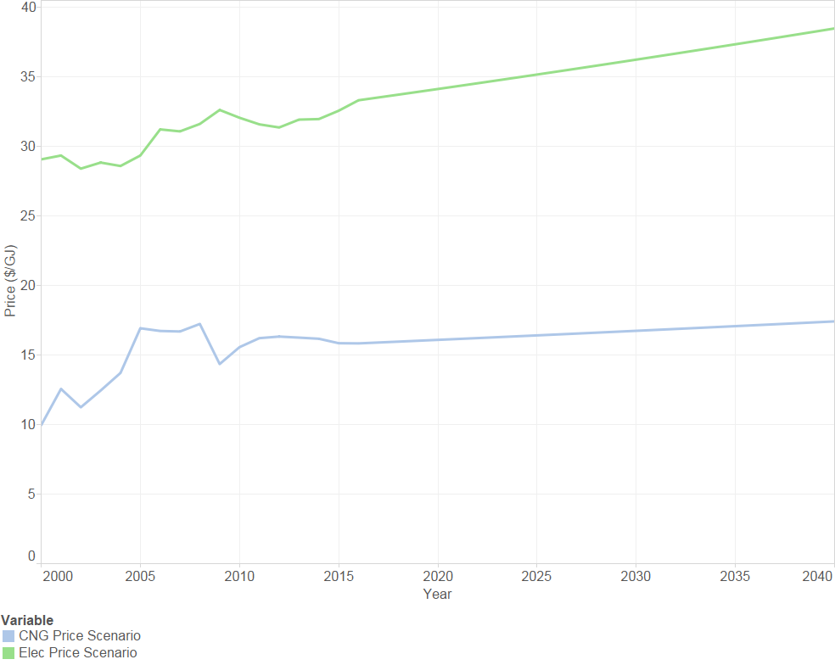
Electricity and CNG Price Scenario
Source: Based on EIA 2000-2014 historic data and AEO 2015 growth rates

Slide 13
Landfill Model’s – Major Elements
Stock and flow of LMOP landfill categories
Logic for landfill closure
Landfill decomposition and biogas production
Landfill waste stream
Techno-economic and investment parameters
Net present value estimates
Exogenous prices

Slide 14
Landfill Model’s – Data Stratification
Landfill Size
EPA definition: more or less than 2.5 million metric ton capacity
Small: Average of 2.4 million metric tons
Large: Average 8.1 million metric tons
Landfill Status
Active
Inactive
Waste Type
Compostable
Other

Slide 15
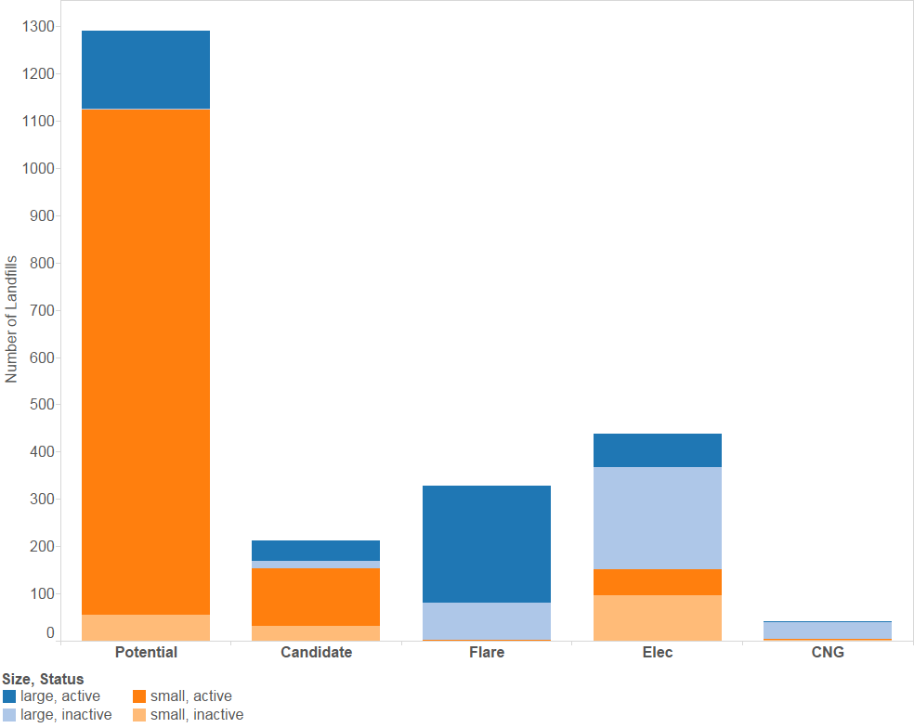
Landfill Accounting
Source: EPA 2013. LMOP dataset

Slide 16
Biogas Production
About 60% of landfill biogas is methane nationally
m³ CH₄/Mt/yr | Small | Large
Inactive | 5 | 7
Active | 4 | 6
Source: Milbrandt 2005, LMOP 2015a

Slide 17
Landfill Model’s - Technology
Conversion efficiency: 99% for CNG and 35% and Electricity
Two pathways to energy technologies
w/ or w/o going through flaring
No industrial learning
Parameter |  | Small Flare | Large Flare | Small Flare to Elec. | Large Flare to Elec. | Small Elec. | Large Elec. | Small Flare to CNG | Large Flare to CNG | Small CNG | Large CNG
Expected Operating Costs | $ | 57 | 160 | 180 | 530 | 240 | 690 | 370 | 960 | 610 | 1,120
Expected Fixed Capital Investment | $ | 1,200 | 3,500 | 3,000 | 5,200 | 4,200 | 8,700 | 3,200 | 5,600 | 4,400 | 9,100
Source: Murray et al. 2014, Stratified using LMOP 2015a

Slide 18
Finance Assumptions
Parameter | Unit | Value | Source
Debt Interest Rate | % | 2 | BSM Model
Required Rate of Return | % | 10 | Expert Judgement
Economic Life | yrs | 20 | LMOP. 2015
Depreciation Period | yrs | 15 | LMOP. 2015
Term of Loan | yrs | 10 | LMOP. 2015
Expected Tax Rate | % | 35 | LMOP. 2015
Expected Equity Fraction | % | 30 | LMOP. 2015
Source:

Slide 19
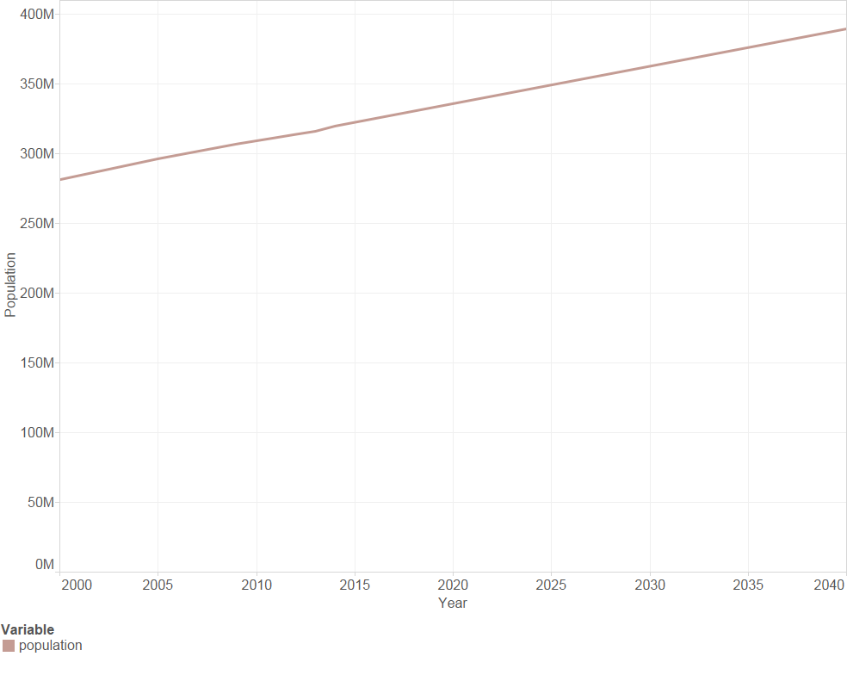
Population
Source: EPA 2013 (using 15 yrs of historic data)

Slide 20
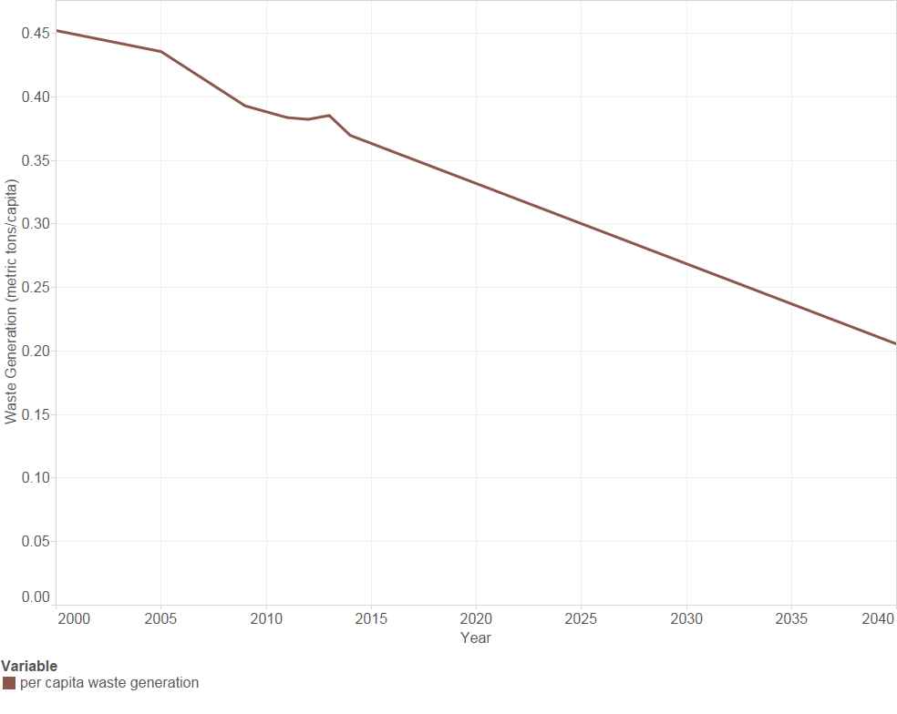
Per Capita Waste for Landfills
Source: EPA 2013 (using 15 yrs of historic data)

Slide 21
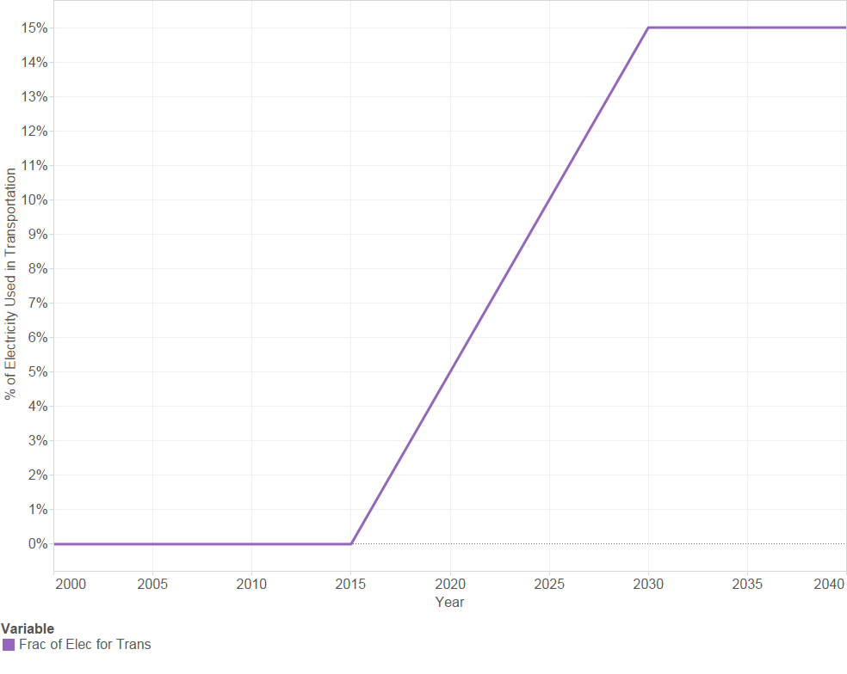
Electricity Used for Transportation
Source: N/A

Slide 22
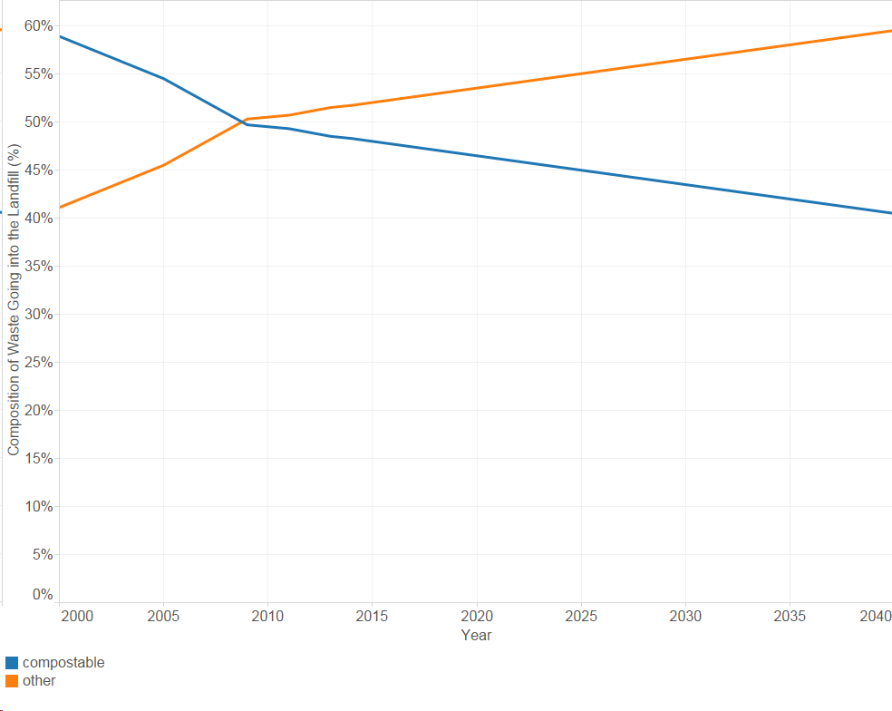
Composition of Waste
Source: EPA 2013 + forecast (using 5 yrs)

Slide 23
Analysis Questions

Slide 24
What Questions is the Model Relatively Well Positioned to Examine?
National or state level scenarios
What is the landfill biogas resource potential in the long-term? How does it change overtime?
How do changes in the waste stream influence the future resource availability?
How do policies influence how the landfill is develop that can be developed?
How to do policies influence the utilization of the resource?

Slide 25
What Questions is the Model Not Relatively Well Positioned to Examine?
Dynamics for the markets where biogas is used
Technological changes overtime
Complex landfill anaerobic dynamics
External changes to the fleet of landfills
E.g., build out of new landfills
Very local conditions
E.g., biogas quality, differences in waste streams

Slide 26
Analysis Goal(s)
What are we really trying to accomplish?
Provide additional assessment of the future resource potential? I.e., build on Anelia/PNNL
Support the development of a strategic plan?
Contextualize the resource within the bioeconomy?
What is feasible in about 2 months?
What is really relevant when only looking at two resources?

Slide 27
Initial Analysis Ideas
Bounding analysis of potential future biogas resources?
Analysis of state specific policies if instituted at the national level.
Role of current (potential future policies) in supporting or directing the use of biogas resources
Role of current (potential future policies) in supporting the increased utilization of landfills?

